Slide 1
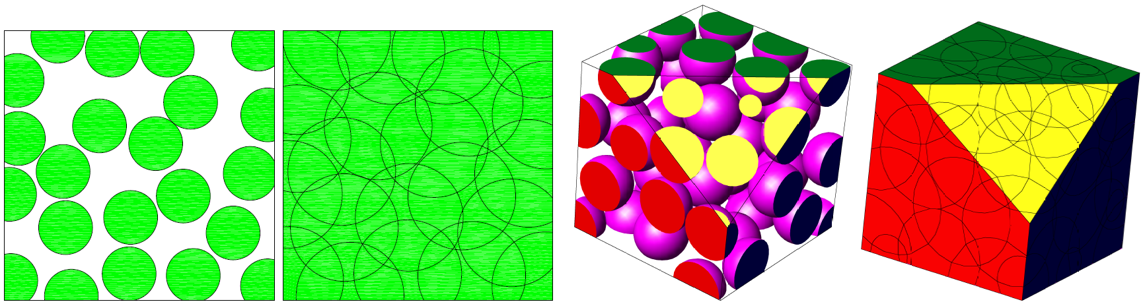


A Simple Algorithm for
Maximal Poisson-Disk Sampling
in High Dimensions
Mohamed S. Ebeida, Scott A. Mitchell, Anjul Patney, Andrew A. Davidson, and John D. Owens
presenter = Scott
Eurographics 2012
Sandia is a multiprogram laboratory operated by Sandia Corporation, a Lockheed Martin Company, for the United States Department of Energy’s National Nuclear Security Administration under contract DE-AC04-94AL85000.
Notes:
I’m talking about uniformly sampling a domain with a random dense packing, as Singapore, rather than Canada with “voids” and a “bias” towards a region

Slide 2
Overview
Classic Dart throwing +
Quadtree
Squares track remaining regions
Track misses for refinement decisions
Avoid refining too deep
[Wei08] Wei L.-Y.: Parallel Poisson disk sampling. ACM Transactions on Graphics 27, 3 (Aug. 2008), 20:1–20:9.
[BWWM10] Bowers J., Wang R., Wei L.-Y., Maletz D.: Parallel Poisson disk sampling with spectrum analysis on surfaces. ACM Transactions on Graphics 29 (Dec. 2010), 166:1– 166:10.
“Make everything as simple as possible, but not simpler.” – A. Einstein
Flat quadtree – one level of squares active, pool of indices
Simpler Datastructure ☺ Less memory ☺
Globally refine periodically, ignore local misses
Simpler Datastructure ☺ More parallel ☺
Refine to machine precision, on average it is so rare that memory is not an issue
More Maximal ☺
“This could be the current algorithm of choice for dart throwing.” – Eurographics reviewer #2
Provable:
Ebeida M. S., Patney A., Mitchell S. A., Davidson A., Knupp P. M., Owens J. D.: Efficient maximal Poisson-disk sampling.
ACM Transactions on Graphics 30, 4 (July 2011), 49:1–49:12
Code works great but we can’t prove the spatial stats theory.

Slide 3
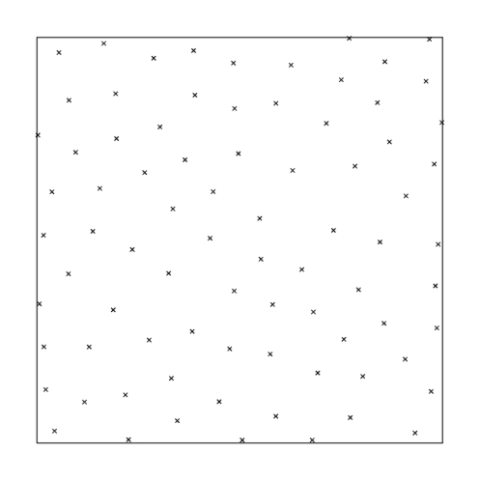
Why MPS? Maximal Poisson-disk Sampling
Properties
Random distribution
Without visible patterns, correlations
Blue noise spectrum
Separated-yet-dense
Efficient-yet-quality interpolation
Graphics
texture synthesis
Mesh generation
Random cracks, quality
Design of computer exp.
high dimensions, 10-100
Fracture Simulations
Courtesy of Joe Bishop (Sandia)

Slide 4
Maximal Poisson-Disk Sampling
What is MPS?
Dart-throwing
Insert random points into a domain, build set X
With the “Poisson” process
Ω
x₄?

Slide 5
Algorithm for MPS
polygonal outer approximation
Classic algorithm
Throw a point, check if disk overlaps, keep/reject
Fast at first, but slows as uncovered area decreases Can’t get maximal.
rejected
sample
uncovered arcgon
Speedup by targeting just the uncovered area
Polygons Ebeida et al. SIGGAPH 2011
Quadtrees to approximate the uncovered area
Discard covered squares
Uncovered squares: a sample is always acceptable
Partially covered squares: may need to refine

Slide 6
Our Algorithm - Basics
Datastructure:
Squares contain uncovered area
Throw darts
Pick square, pick point in square
If dart is outside nearby circles
Accept dart as sample
Delete square
Refine all squares
Discard subsquares covered by single disks
Repeat
darts
refine
darts
refine

Slide 7
Datastructure: Quadtree Root
Squares sized so
Can fit at most one sample
Top square diagonal =
sampling radius
Nearby square template for “Point in disk?” conflict check
Pointer from square to its sample
y
x
Unpublished extension: use kd-tree for proximity…

Slide 8
Datastructure: Flat Quadtree Leaves
Flat: Only one level i is used at a time
Pool of squares
Global level i
Squares that might accept a sample
Array of indices C
0
1
2
3
C^{i}
0
(0,0)
i=3 i.e. initial ✕ 2^{i} squares per side
1
(0,2)
(0,3)
2
(1,1)
end
3
…

Slide 9
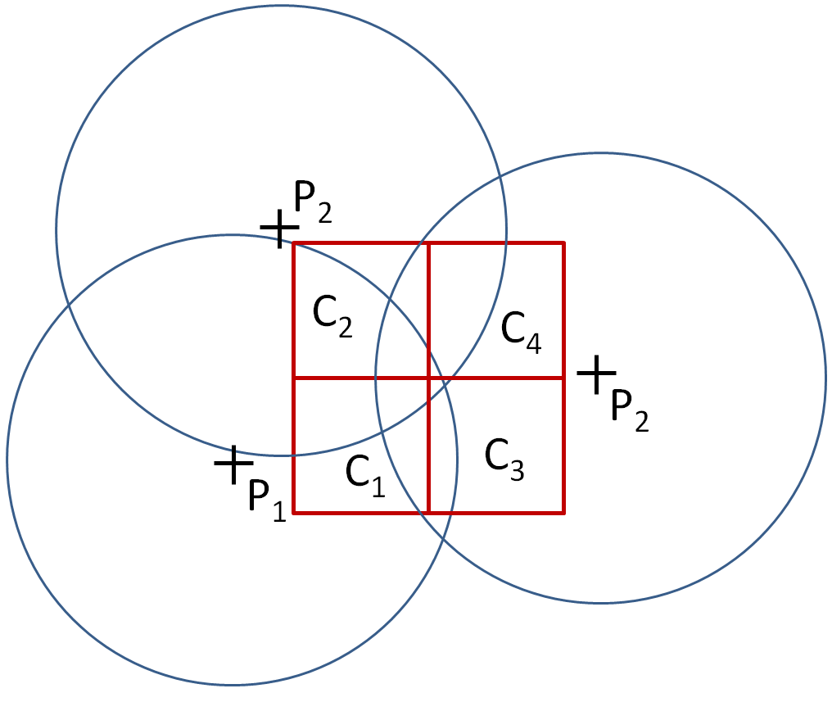
Flat Quadtree Refinement
Update in place.
i++
C^{i}
(0,0)
0
1
2
3
(0,2)
(0,3)
pop
0
end
_{(x,y)➔{2x,2x+1}x{2y,2y+1}}
(0,3)➔{(0,6) (0,7) (1,6) (1,7)}
…
1
subsquare in circle?
2
end
push x4
3
C^{i+1}

Slide 10
Level Limit?
one uncovered point
(or is it covered? let’s look closer…)
Problem
Test if square in single circle
Small voids require infinite refinement
Solution: [Wei08], [BWWM10
Stop early to avoid memory blow-up
Solution: Us
Refine to finite-precision
Small voids happen rarely on average so
Memory is fine in practice
Benefit: maximal
…
High d
new sphere
covers it

Slide 11
Algorithm – outer loop parameters
Tuning parameter choices: A, B
Cº = number initial cells
C^{i} = number current squares
How many throws before refining?
Throws = A | C^{i} |
How big does array C need to be to hold all the refined grid cells?
C = B | Cº |
Big A ⬅➔more time, smaller memory B

Slide 12
A (time) and B (memory) parameters
Big A ⬅➔more time, smaller memory B
A≈1, B≈dimension. (A increases for d>4)
Insensitive to value of A above a threshold
Intuition: as classical dart throwing, most hits happen early, no benefit to more throws

Slide 13
Time and Memory Experimental results
Memory and time peaks in early interations
Exponential convergence thereafter
Log y scale
#boxes ≈ time, memory,

Slide 14
Time and Memory
vs. true quadtrees (Gamito), polygons (Ebeida 2D)
all linear in both, but constants matter
log-log scales
Time
Memory
Memory savings from simpler datastructure
Time savings from that + simpler/fewer checks

Slide 15
Time and Memory Theory
Run-time
Practice: linear in #points, grows by dimension
Proof: not available
Spatial statistics, expected area fraction of cells? And where?
Memory
Linear in #points
No dynamic memory allocation
Time
Memory

Slide 16
GPU
Rejection sampling is great on a GPU
Nothing to communicate for a dart miss!
10x speedup on NVIDIA GTX 460
Memory-limited to 600k points 2d, 200k in 3d

Slide 17
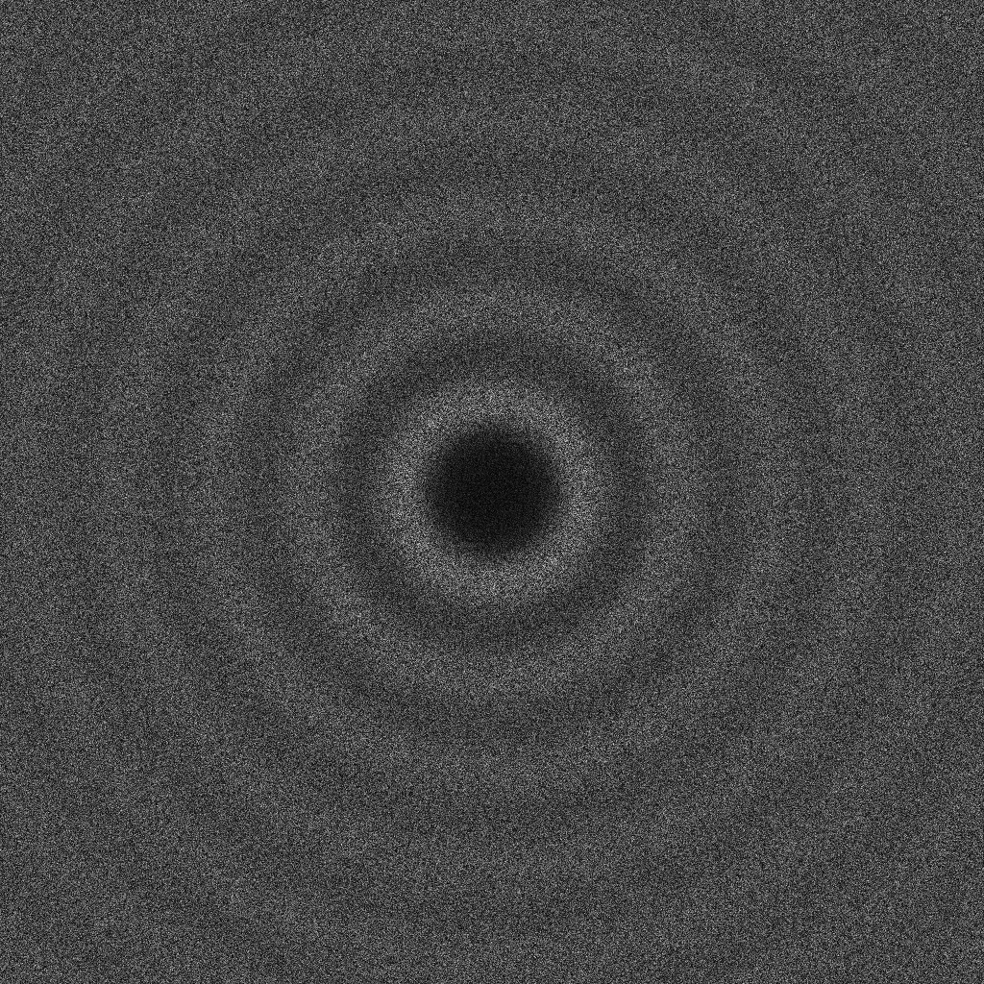
Point Cloud Quality? Provably correct bias-free, maximal up to precision
Experiments confirm
(GPU)

Slide 18
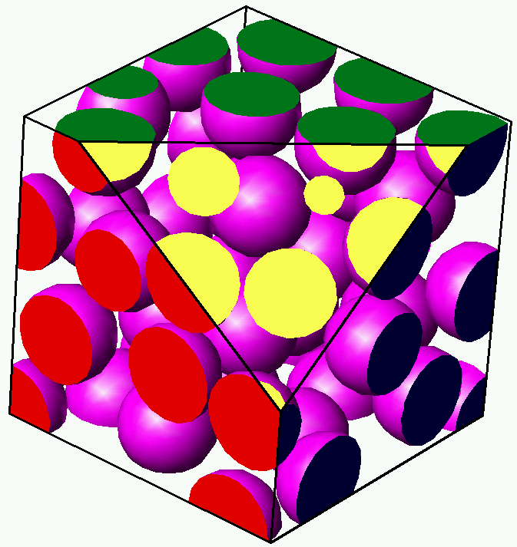
Conclusions
darts
MPS Maximal Poisson-disk sampling
Simpler, faster, less memory
Three simple ideas
Flat quadtree
Constant # throws / ignore misses
Global refinement
CPU and GPU
Reviewer #0: “The paper is yet another one about faster Poisson-sampling, but I see that it is significantly faster, uses less memory, is just simpler, easier to implement, and works well for higher dimensions.”
Future, dimensions > 4?
Not so great, quadtrees too big
Two bonus thoughts…
refine
darts
refine

Slide 19
Two bonus thoughts

Slide 20
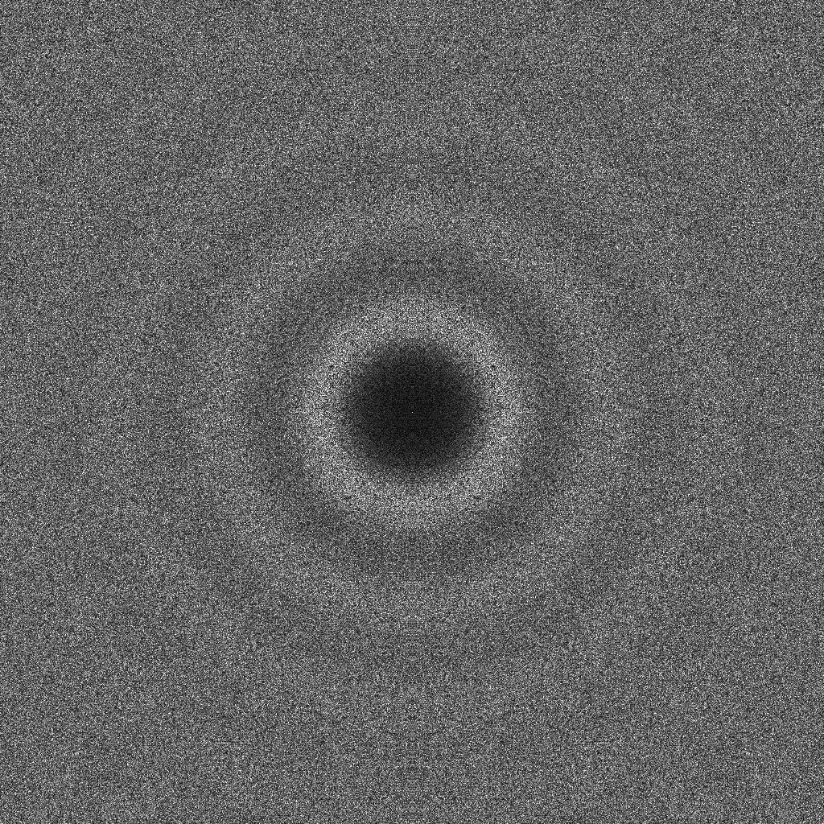
“Unbiased” Opinion
Unbiased as a description of (serial) process
insertion probability independent of location
Unbaised as a description of outcome
pairwise distance spectra, blue noise
Unbiased process leads to unbiased outcome, but so might other processes
Opinion: need something beyond “viewgraph norm”
Need metrics for “how unbiased is it”
Define spectrum S that is the limit distribution of unbiased sampling, and standard deviations.
Our process generated S’, and |S-S’| < 0.4 std dev (S)
Ω
x_{i}?
PSA code great for standard pictures

Slide 21
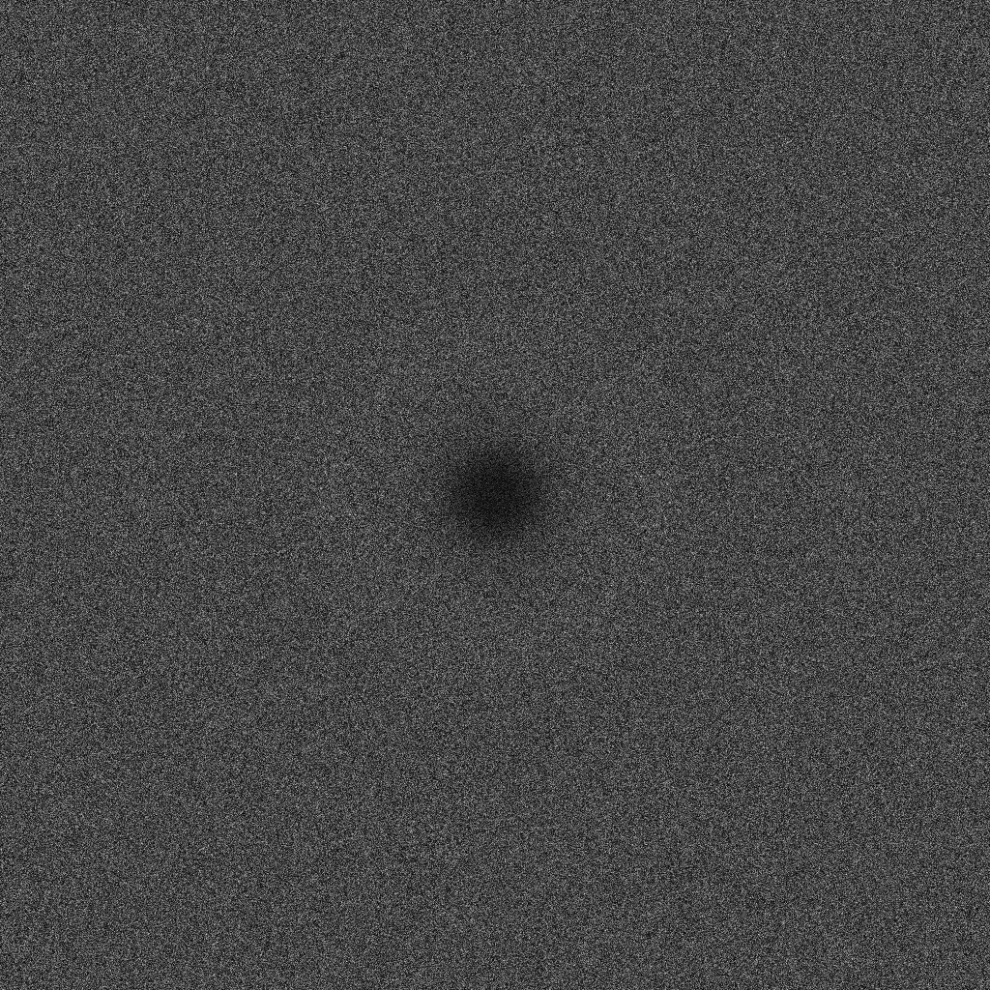
What is the real goal?
Classic MPS – a lot of effort to get maximal
coverage
Two-radii MPS, submitted to CCCG
x
exclusion

